Slide 1
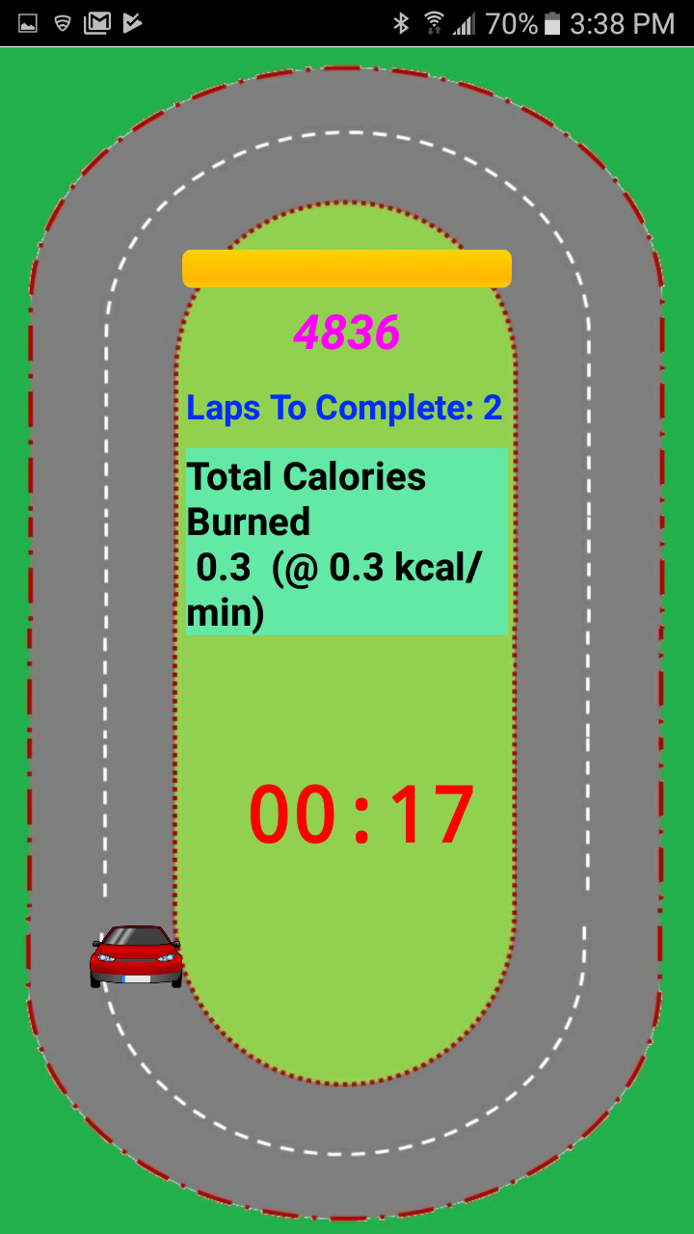
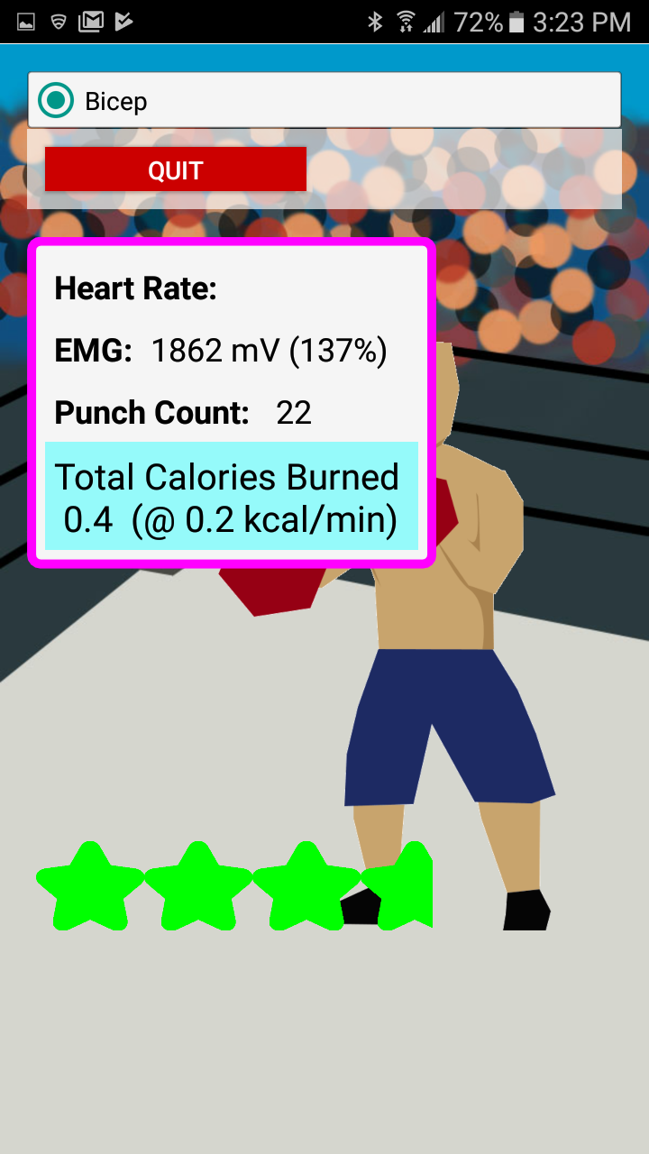
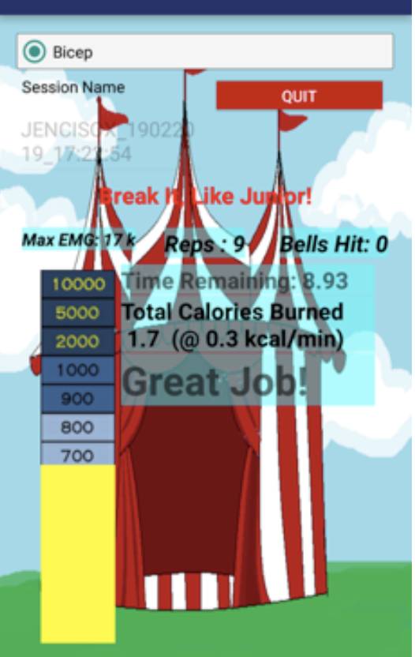
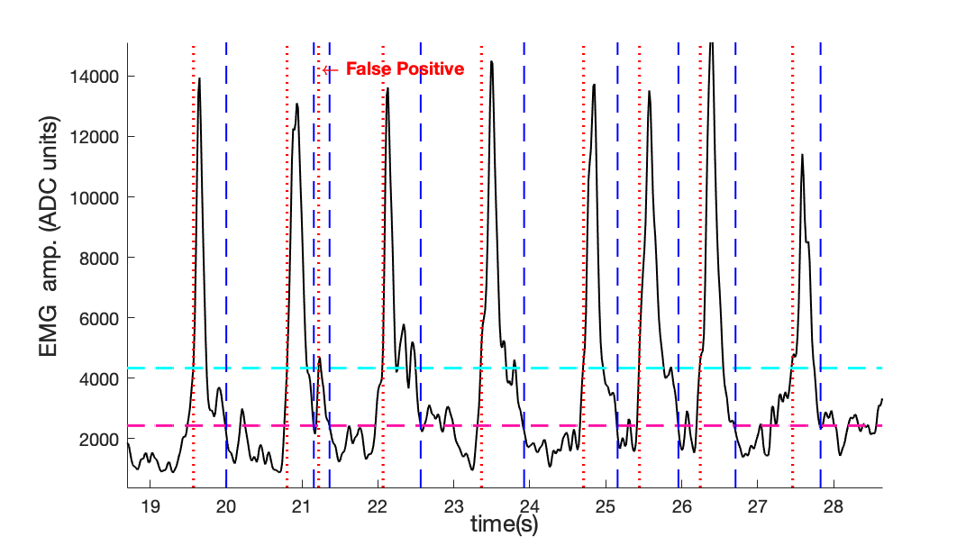
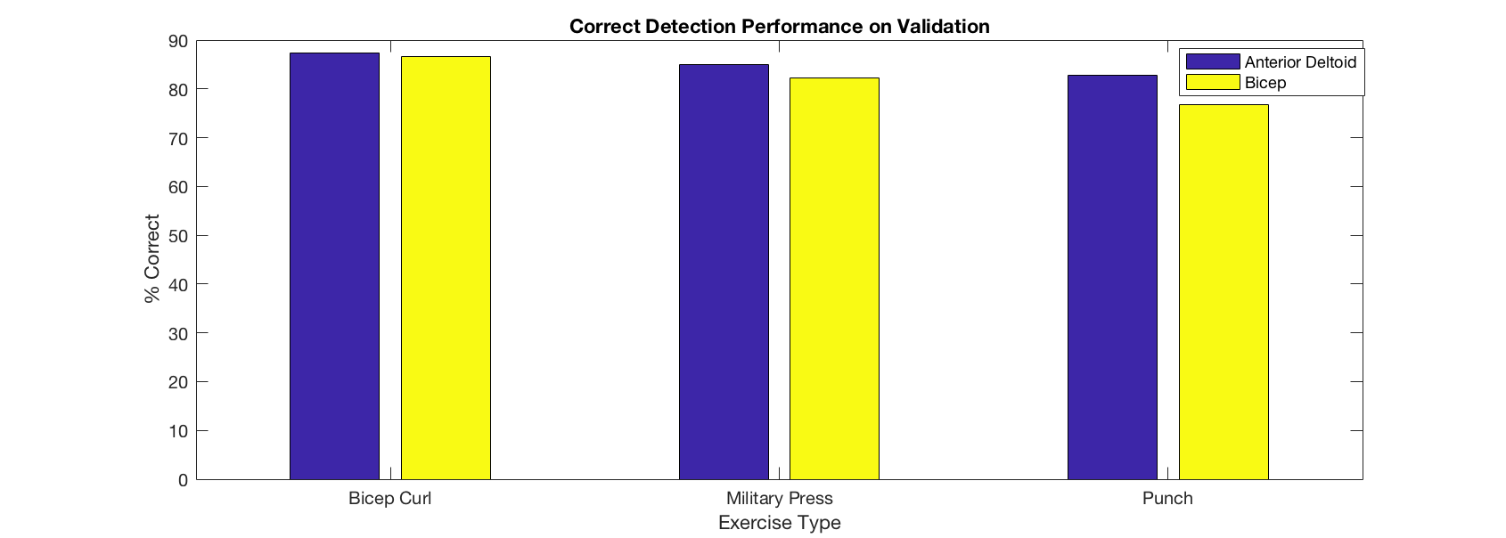
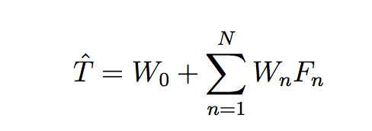
A Model for Automating Thresholds in a Muscle Activity-Based Exergaming App
Abigail Garcia, James Enciso, Luis Lopez-Juarez, James Velasco, Padraic Castillo, Deborah Won Electrical and Computer Engineering California State University, Los Angeles
Background
Increasing prevalence of cardiometabolic disorders for people in wheelchairs
Common barriers to regular exercise for individuals who use wheelchairs due to lower limb mobility impairment include:
transportation
finding accessible gym equipment
access to physical therapy
Developed a mobile fitness app (WOW-mobile)
Interfaces with wireless sensors
tracks physical activity levels
3 “exergames” driven by muscle (EMG) activity, tailored for exercising in wheelchairs in the convenience of the user’s own home.
Racing (spinning)
Boxing (exchange)
High striker (resistance arm band)
User friendliness limited by need for calibrating thresholds before each session due to variability from session to session in precise electrode location, noise sources, and in level of user’s muscle conditioning.
Figure 1. Screenshots of three exergames; track game (left), boxing game (center), high striker game (right)
Figure 2. Peak detection performance on EMG sample using predicted thresholds produced by our automated process. Detected contractions are denoted by the dashed lines and false positives are indicated.
Goodness of Fit R² Values
 | Ant-Delt |  | Bicep
 | UT | LT | UT | LT
Punches | 0.68 | 0.73 | 0.61 | 0.38
Bicep Curls | 0.97 | 0.99 | 0.55 | 0.75
Military Press | 0.67 | 1.00 | 0.75 | 0.69
Table 1. Coefficient of determination (R²) between EMG thresholds generated by the multiple linear regression model vs anthropometric and physiological (age, weight, height, and maximum heart rate) variables; for upper (UT) and lower (LT) thresholds for each of the three exercises.
Discussion
Linear regression of EMG thresholds vs. age, weight, height, and max HR, yields on average 76% accuracy, according to goodness of fit R² metric (range of 0.38 – 1.00)
Regressions for the anterior deltoid consistently outperformed those for the bicep thresholds.
Regressions for the resistance exercises (bicep curls and military press) outperformed the punching exercise.
When using thresholds derived from our model, the accuracy of EMG contraction detection across the test data was approximately 80%.
Objective
To drive the game engine of three different “exergames” by automatically generating user-specific thresholds for exercising in wheelchairs in the convenience of the user’s own home.
Table 2 and Figure 3. Algorithm Performance breakdown by exercise type using estimated thresholds validated on their data sets for bicep and anterior deltoid
Methods
Ten subjects performed consistent exercises while wearing sensors:
Flexdot electromyography (EMG) sensor (Dynofit, Inc.) on the bicep and Anterior Deltoid
Alpha, MioGlobal, Inc. – a wrist-worn heart rate monitor
Upper and lower thresholds were estimated using a linear regression derived from age, height, weight, max heart rate, and maximum voluntary contraction.
Conclusions
Multiple linear regression based on user’s height, weight, age and maximum heart rate can be used to automatically set user thresholds for EMG-based exergaming to make for a more user friendly mobile exergaming experience.
Acknowledgements
CSUPERB Presidential Scholars Grant
Cal State Instructionally Related Activities grants

