Slide 1
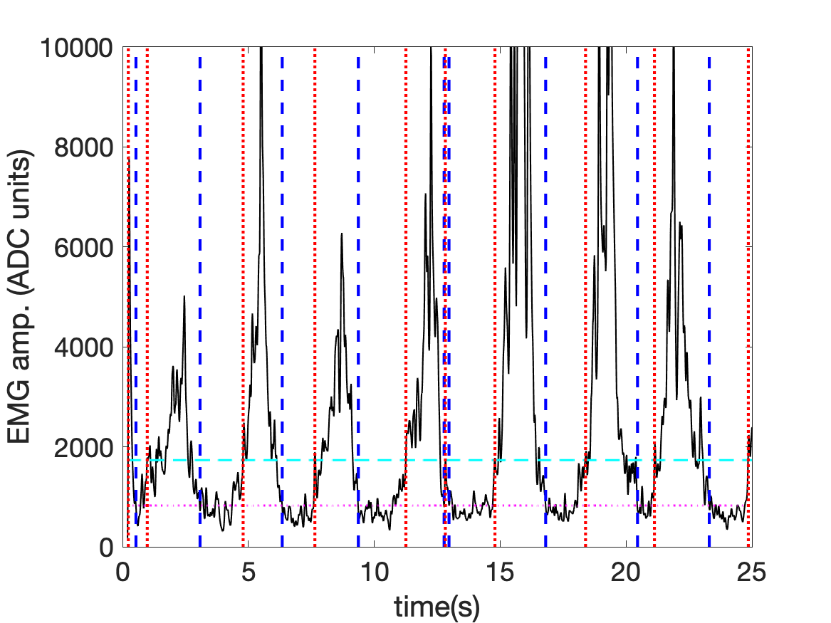
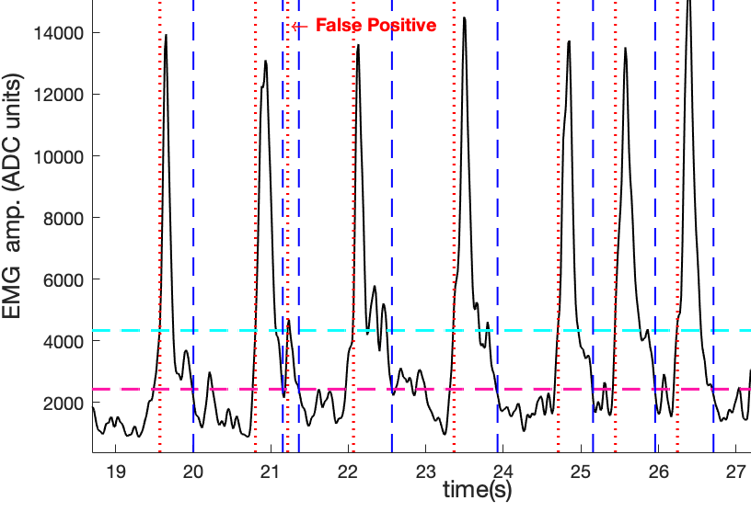
Automating Threshold Calibration for EMG-based Exergaming
Abigail Garcia, James Enciso, Luis Lopez-Juarez, James Velasco, Padraic Castillo, Deborah Won Electrical and Computer Engineering California State University, Los Angeles
Background
Increasing prevalence of cardiometabolic disorders for people in wheelchairs
Common barriers to regular exercise for individuals who use wheelchairs due to lower limb mobility impairment:
transportation
finding accessible gym equipment
access to physical therapy
Developed a mobile fitness application (WOW-mobile)
communicates with wireless sensors
tracks physical activity levels
3 “exergames” driven by muscle (EMG) activity, tailored for exercising in wheelchairs in the convenience of the user’s own home.
Racing (spinning)
Boxing (exchange)
High striker (resistance arm band)
User friendliness limited by need for calibrating thresholds before each session due to variability from session to session in precise electrode location, noise sources, and in level of user’s muscle conditioning.
Figure 2. Sample data when applying the thresh-olds predicted by our automated process to test data. Example of false positive and missed detections is shown.
Figure 1. Example showing the EMG from one participant (solid) with the starts (vertical dashed blue lines) and ends (vertical dotted red lines) of the detected contractions based on automatically determined thresholds.
Discussion
Linear regression of EMG thresholds vs. age, weight, height, and max HR, yields on average 73% accuracy, according to goodness of fit R² metric (range of 0.38 – 1.00)
Regressions for the anterior deltoid consistently outperformed those for the bicep thresholds.
Regressions for the resistance exercises (bicep curls and military press) outperformed the punching exercise.
When using thresholds derived from our model, the accuracy of EMG contraction detection across the test data was approximately 80%.
Goodness of Fit R² Values
 | Ant-Delt |  | Bicep
 | UT | LT | UT | LT
Punches | 0.68 | 0.73 | 0.61 | 0.38
Bicep Curls | 0.97 | 0.99 | 0.55 | 0.75
Military Press | 0.67 | 1.00 | 0.75 | 0.69
Objective
Drive the game engine of three different “exergames” tailored by automatically generating user specific thresholds for exercising in wheelchairs in the convenience of the user’s own home .
Methods
Ten subjects performed consistent exercises while wearing sensors:
Flexdot electromyography (EMG) sensor (Dynofit, Inc.) on the bicep or Anterior Deltoid
Alpha, MioGlobal, Inc. – a wrist-worn heart rate monitor
Thresholds for each of the games and muscles were regressed against : age, height, weight, max heart rate, and maximum voluntary contraction.
Multiple linear regression was carried out using Matlab’s regress function
Conclusions
Multiple linear regression based on user’s height, weight, age and maximum heart rate can be used to automatically set user thresholds for EMG-based exergaming to make for a more user friendly mobile exergaming experience.
Table 1. Coefficient of determination (R^2 ) between EMG thresholds generated by the multiple linear regression model vs anthropometric and physiological (age, weight, height, and maximum heart rate) variables; for upper (UT) and lower (LT) thresholds for each of the three exercises.
Acknowledgements
CSUPERB Presidential Scholars Grant
Cal State Instructionally Related Activities grants

